Slide 1
Self-Playing Guitar
CS Group 22 / ECE Group 30
Notes:
Pedro

Slide 2





Team Member Introductions
Pedro Contipelli (CS) - Project Manager, MIDI Preprocessing, & Motor Control Algorithm
Blake Cannoe (CpE) - Motor Integration & Server Backend
Ethan Partidas (CpE) - Motor Control Algorithm & Motor Mount Design
Kyle Walker (EE) - PCB Circuit Design & Power Supply Design
Jon Catala (EE) - PCB Circuit Design & Circuit Implementation
Notes:
Pedro

Slide 3
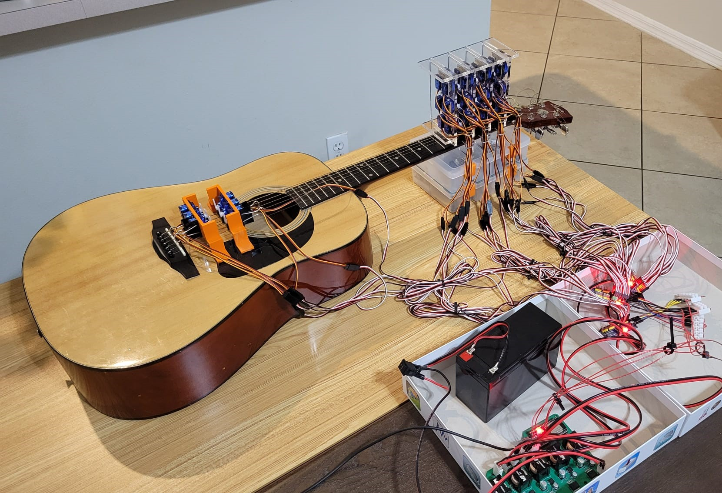
Project Description
Fully autonomous robotic guitar that uses motors to play any song that is input to the system via MIDI file (both strumming and fretting)
Notes:
Pedro

Slide 4
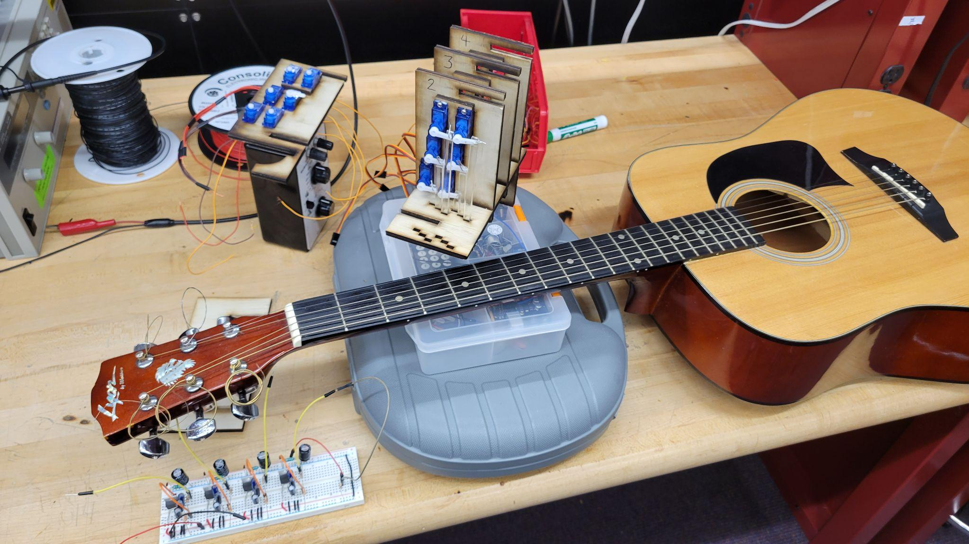
Project Description [OLD]
Fully autonomous robotic guitar that uses motors to play any song that is input to the system via MIDI file (both strumming and fretting)
Notes:
Pedro

Slide 5
Project Goals
Foster interest in STEM fields for children and make the field more accessible by using a universal language anyone can understand
Bridging the gap between engineering and art
Learn from each other, while working as a team to create something none of us could have done alone
Produce an entertaining display and listen to some good tunes!
Notes:
Pedro

Slide 6
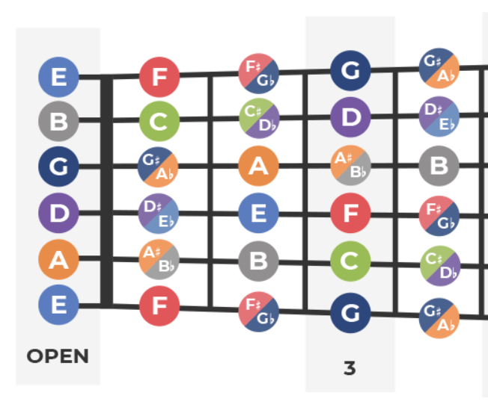
Requirements
Self-contained power (i.e. Battery)
Ability to process any input MIDI file
Access full range of 4 frets (~2.5 octaves between E2 - G#4)
Must be able to independently fret and strum multiple strings at once
3A maximum current draw
Notes:
Pedro

Slide 7
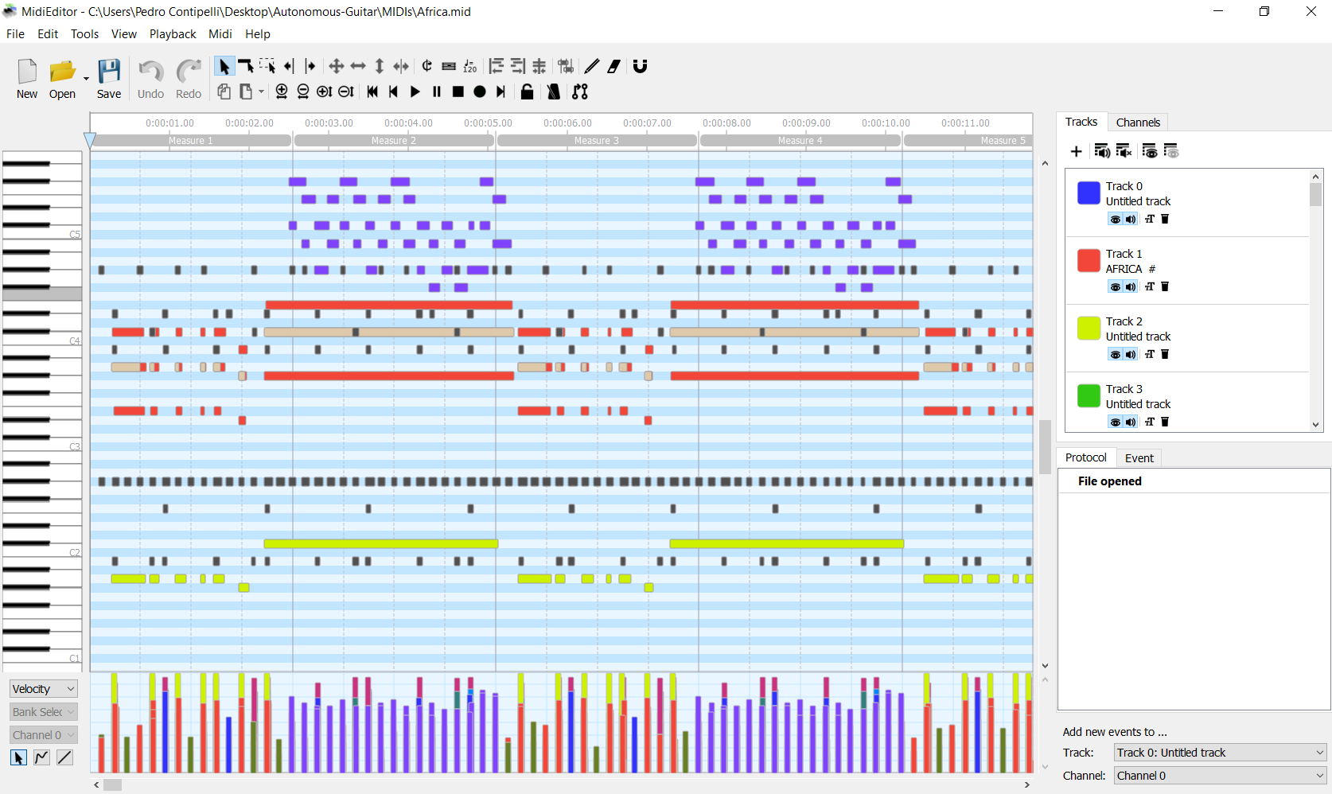
Detailed Design: MIDI Preprocessing (Input)
Notes:
Pedro

Slide 8
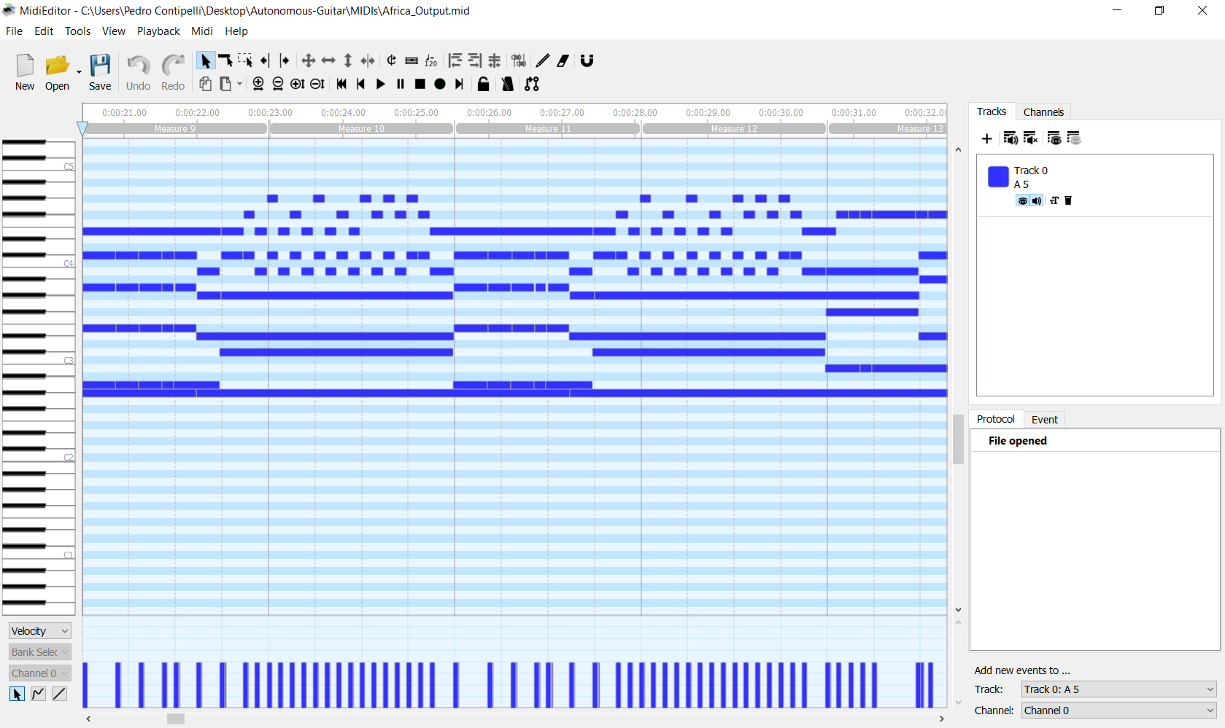
Detailed Design: MIDI Preprocessing (Output)
Notes:
Pedro

Slide 9


Detailed Design: MIDI Preprocessing Algorithm
Input MIDI file
Mute/remove unplayable tracks (drums, synth, etc) and combine all into single track
Range Shift to maximize playable notes
Loop through track, ignoring unplayable instructions
Compress outlier notes into playable range
Force end overlapping notes occurring on same string
2nd pass loop through track
Remove notes that happen in succession too quickly
(to ensure enough spacing between notes that is physically possible)
Output new MIDI file
Notes:
Pedro

Slide 10


Microcontroller Motor Output Code
Code written in MicroPython using UMidiParser library
Can play 6 independent notes simultaneously (1 per string), thus 12 servo outputs (6 for strumming & 6 for fretting)
Servo on the neck presses down slightly before the string is plucked
Improved angle control fine-tuning and managing current draw
Notes:
Pedro

Slide 11
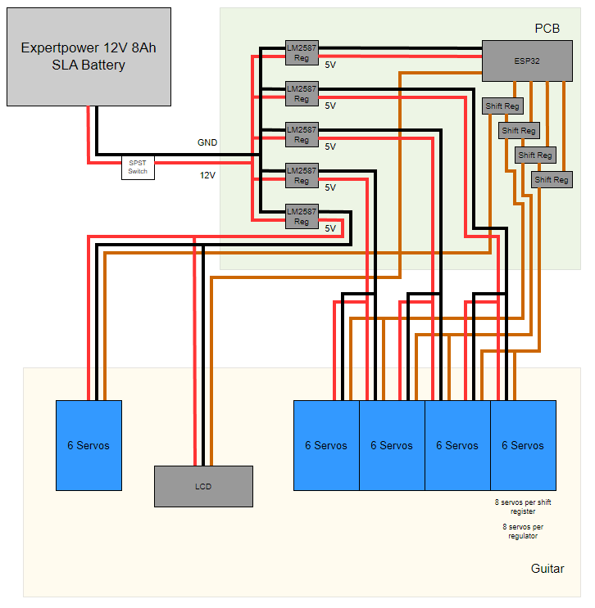
Hardware Design - Initial Block Diagram
Notes:
Kyle

Slide 12
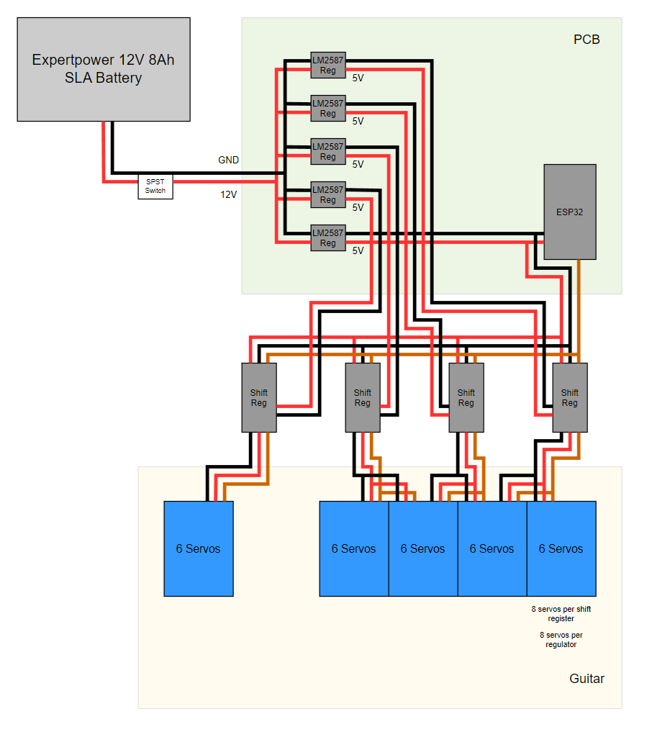
Hardware Design - Final Block Diagram
Notes:
Kyle

Slide 13
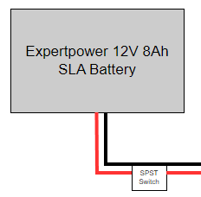
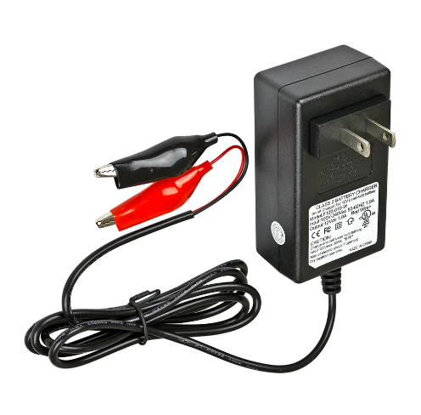
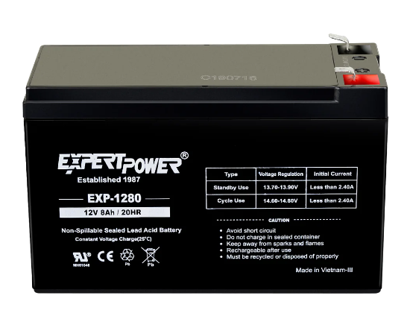
Detailed Design: Power Source
12V Output Voltage
8Ah (Can output 8A for 1 hr)
Estimated Worst-Case Current Load of 8.6A
Estimated Typical Current Load of 2.5A
Experimental Typical Load approximately 2A
Notes:
Kyle

Slide 14
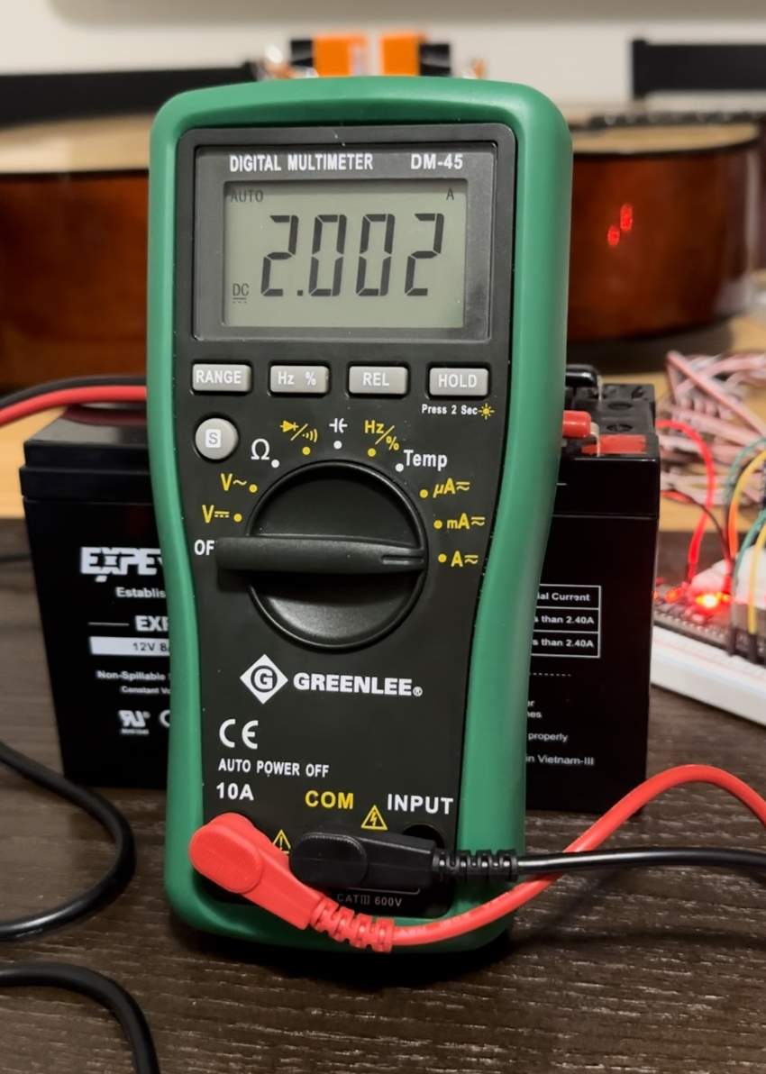
Detailed Design: Power Source
Notes:
Kyle

Slide 15
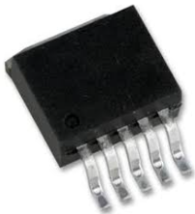
Detailed Design: Regulators
LM2576 Switching Regulator
3A Max
5 Regulators
Both Through-Hole and SMT packages
Distribution of heat
Allows for convenient utilization of TI resources
Notes:
Kyle

Slide 16
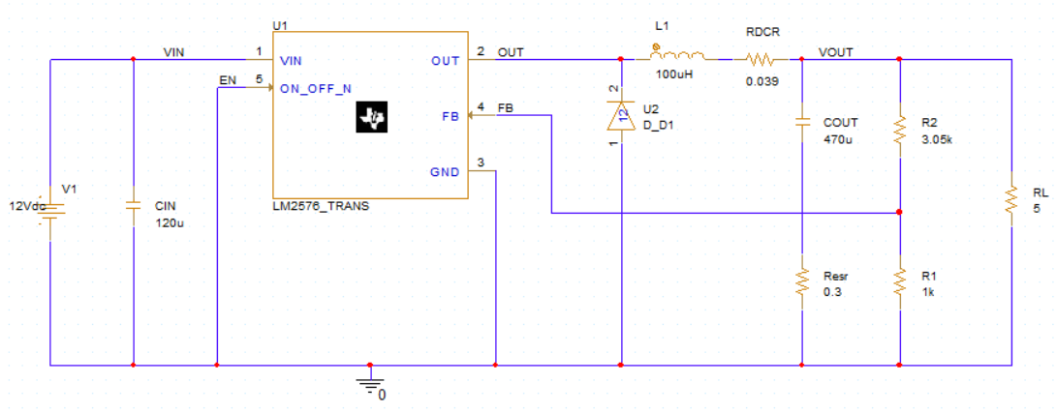
Testing: Regulator Schematic
Notes:
Kyle

Slide 17
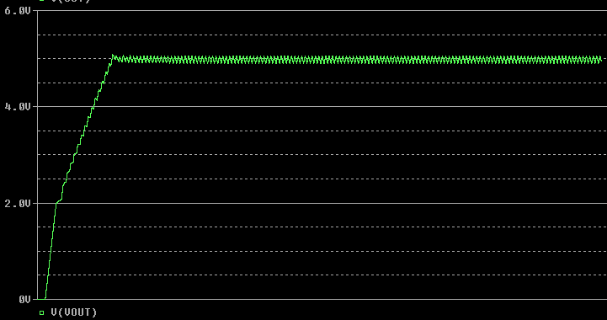
Testing: Regulator Simulation
Notes:
Kyle

Slide 18
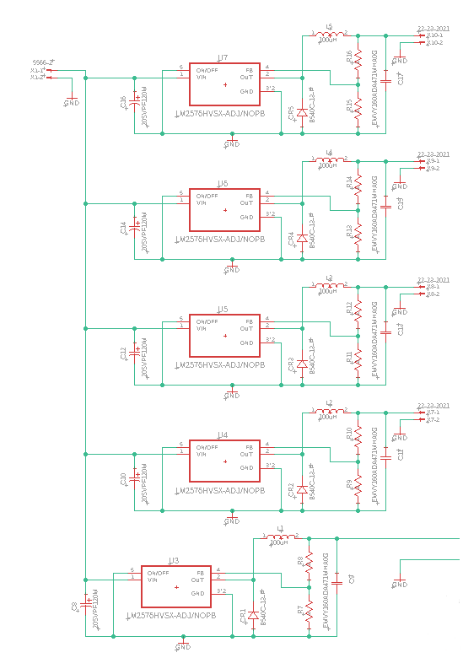
Detailed Design: Power Supply Schematic
Notes:
Kyle

Slide 19
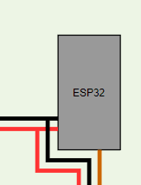
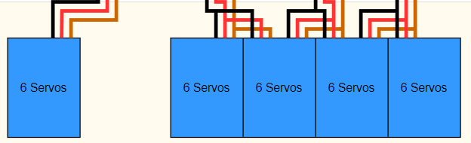
Power Distribution
5 servo assemblies, 6 servos each
24 servos for Fretting Assembly
6 servos for Strumming Assembly
8 Servos per Regulator
4 Regulators to power Servo
5th Regulator for ESP32
Regulator Load Isolation
Notes:
Kyle

Slide 20
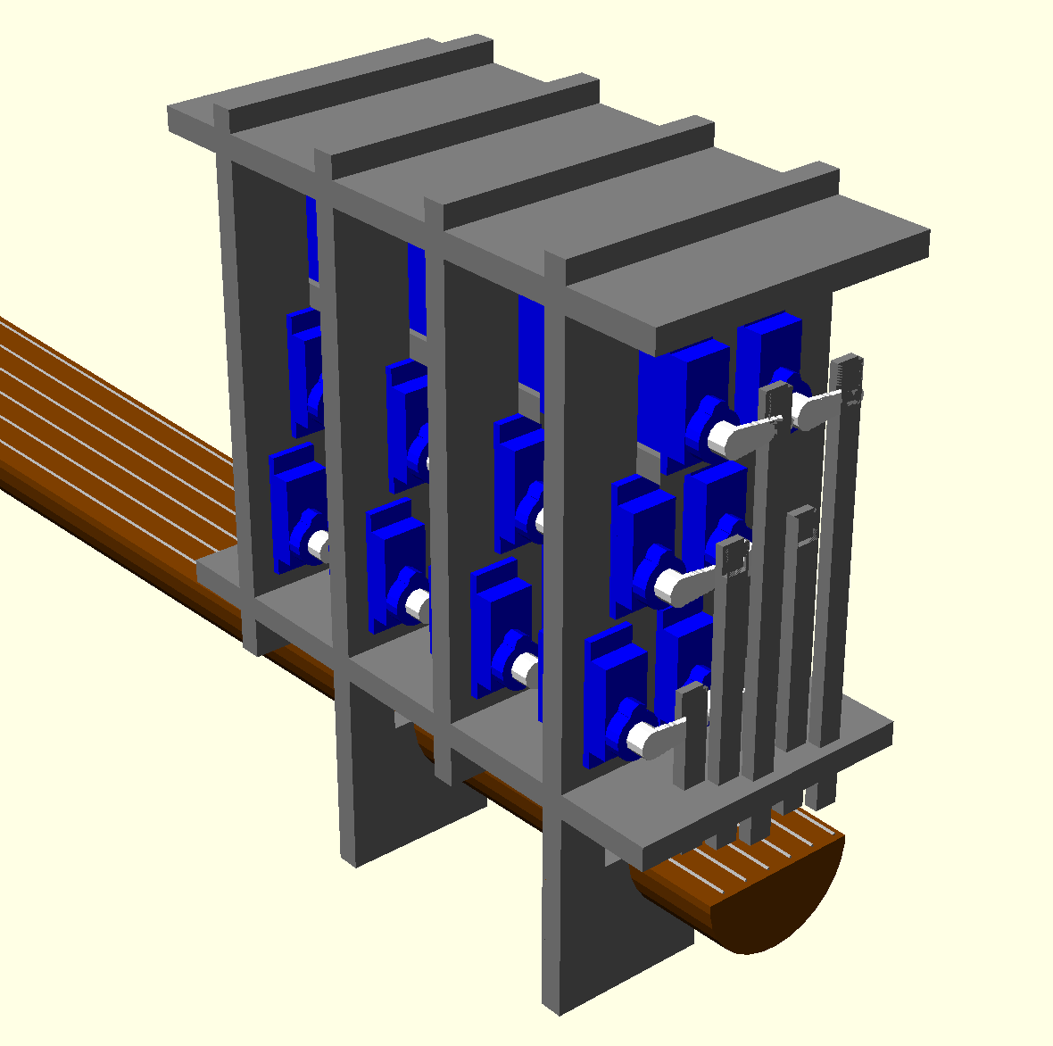
Mechanical Design: Modeling Software
Fretting Mechanism OpenSCAD Model
Why OpenSCAD?
Code-based modeling: Low learning curve for CpE major.
Support for 3D-printing and laser cutting.
Notes:
Ethan

Slide 21
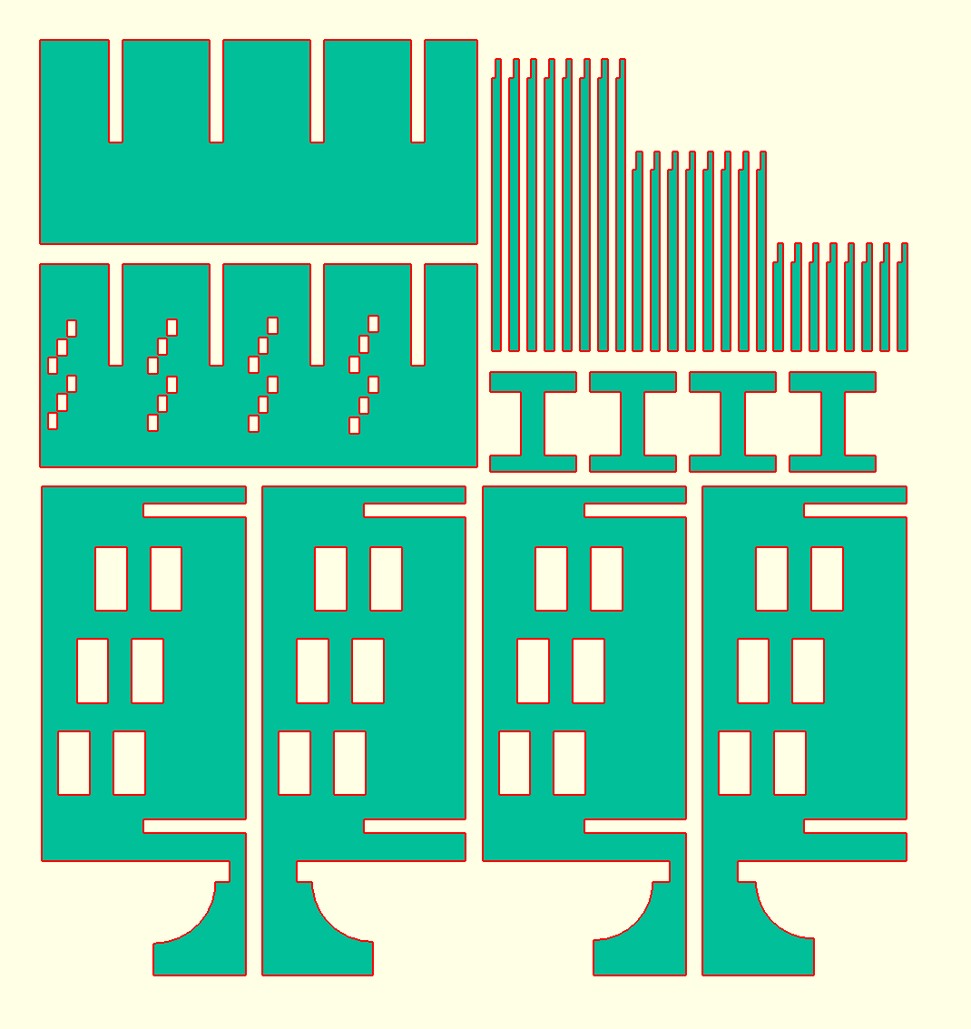
Mechanical Design: Fabrication Materials
Material | Cost | Yield
3D-printed plastic | >$100 | 1 prototype
Plywood | $25 | 8 prototypes
Acrylic | $25 | 1 prototype
Original plan was 3D printing, but switched to plywood due to cost. Model had to be adjusted to match the plywood’s ¼ inch thickness.
Notes:
Ethan

Slide 22
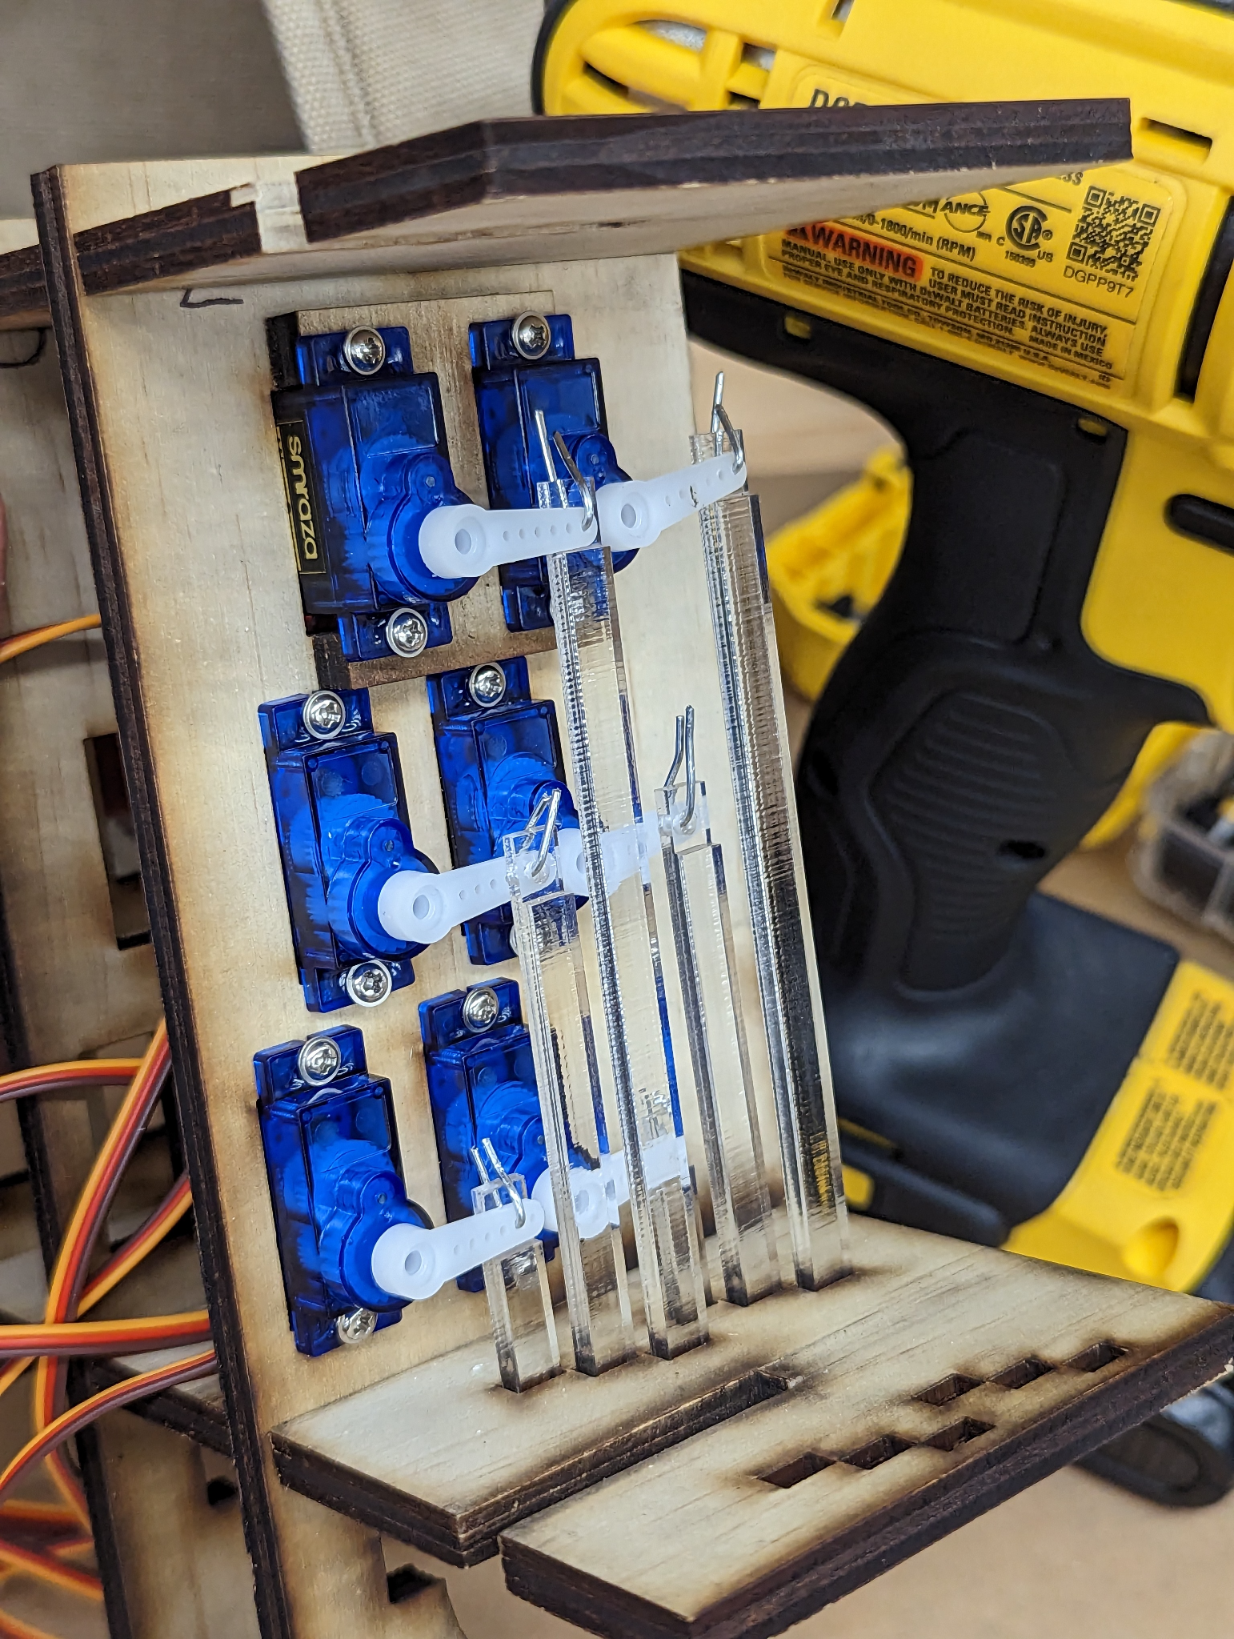
Mechanical Design: Reinforcement
Problem: Wooden arms are too fragile, split apart easily.
Solution: cut only the arms out of acrylic, use lower cost plywood for everything else. Acrylic cost an additional $25. Still cheaper than 3D printing.
Notes:
Ethan

Slide 23
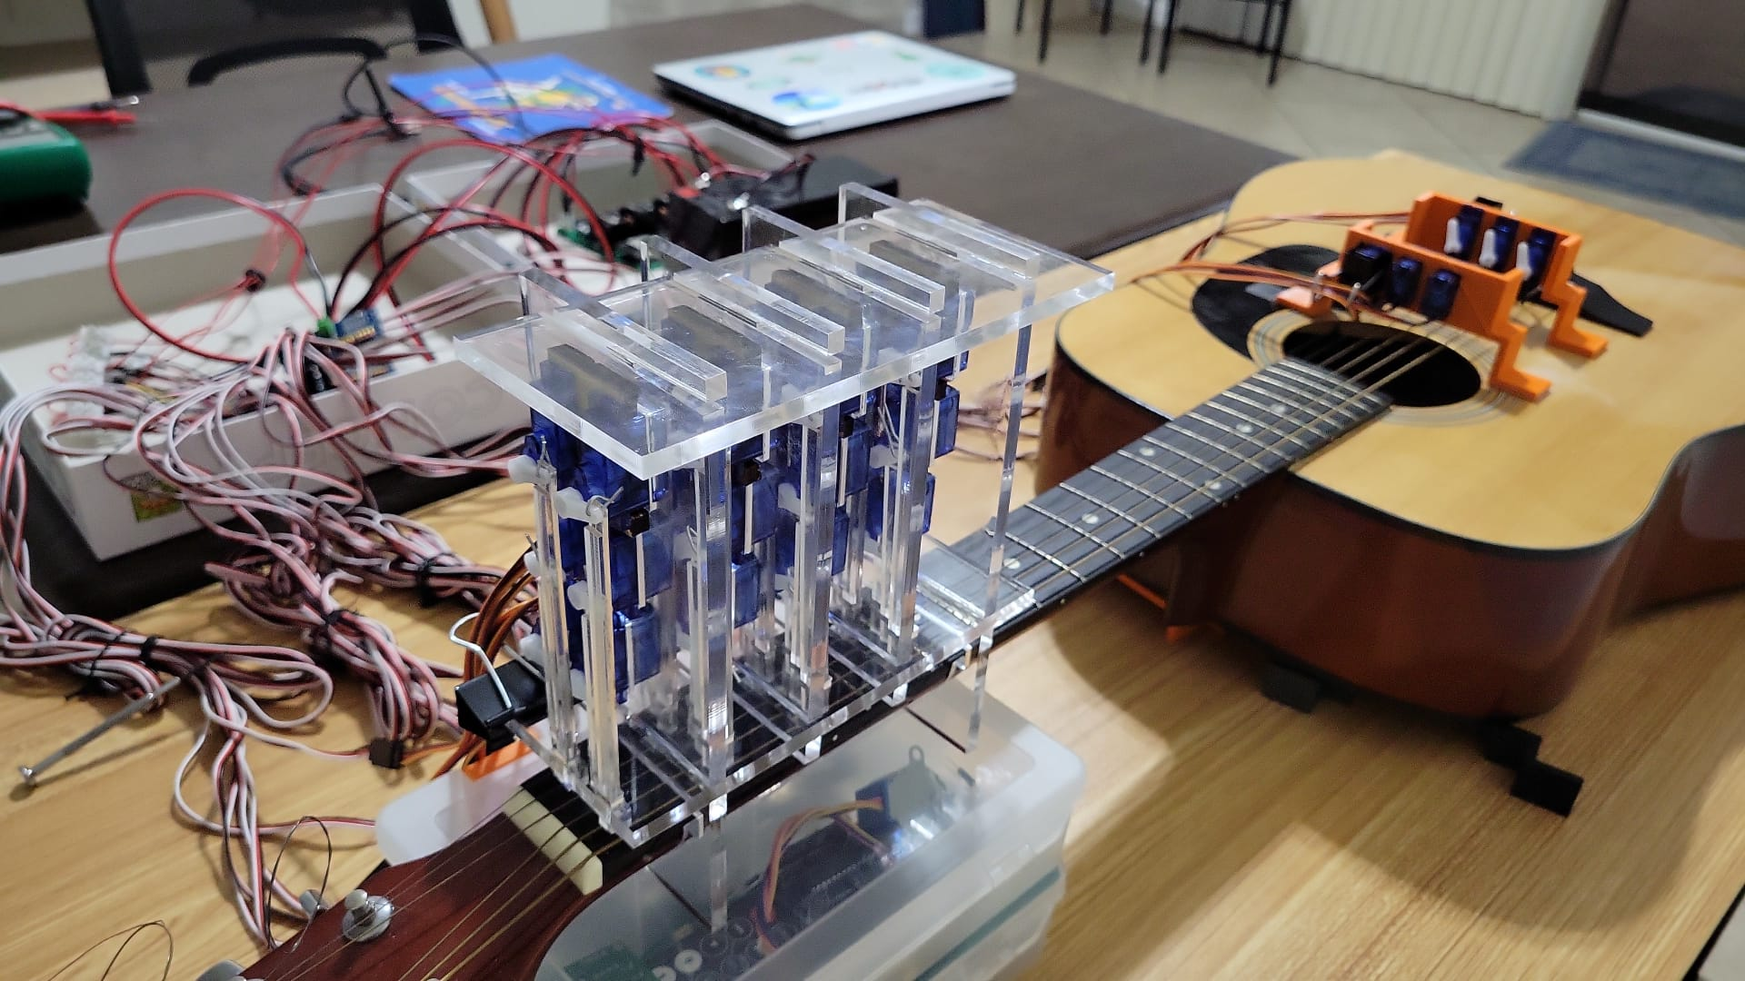
Mechanical Design: Final Designs
Notes:
Ethan

Slide 24
MCU Comparison
MCU | Cost | Speed | Pins | USB | Bluetooth
Arduino Due | $46 | 84 MHz | 54 | No | No
Asus Tinker Board | $75 | 4 x 1.8 GHz | 28 | Yes | Yes
ESP32 | $15 | 160 MHz | 34 | No | Yes
Libre Computer Board | $45 | 4 x 1.5 GHz | 35 | Yes | No
MSP430FR6989 | $20 | 16 MHz | 48-83 | No | No
Onion Omega 2 | $53 | 4 x 2.0 GHz 4 x 1.6 GHz | 26 | Yes | No
Odroid XU4 | $29 | 580 MHz | 18 | No | Yes
Raspberry Pi 3 Model B | $156 | 4 x 1.2 GHz | 26 | Yes | Yes
Notes:
Blake

Slide 25
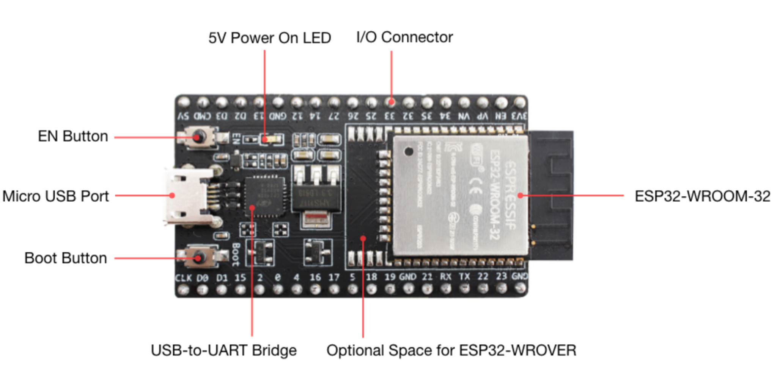
Detailed Design: Dev Board components
Voltage Regulator
ESP 32
Micro USB
USB to UART connection
Switch Buttons
Pin Connectors
Notes:
Kyle (Formerly Jon)

Slide 26
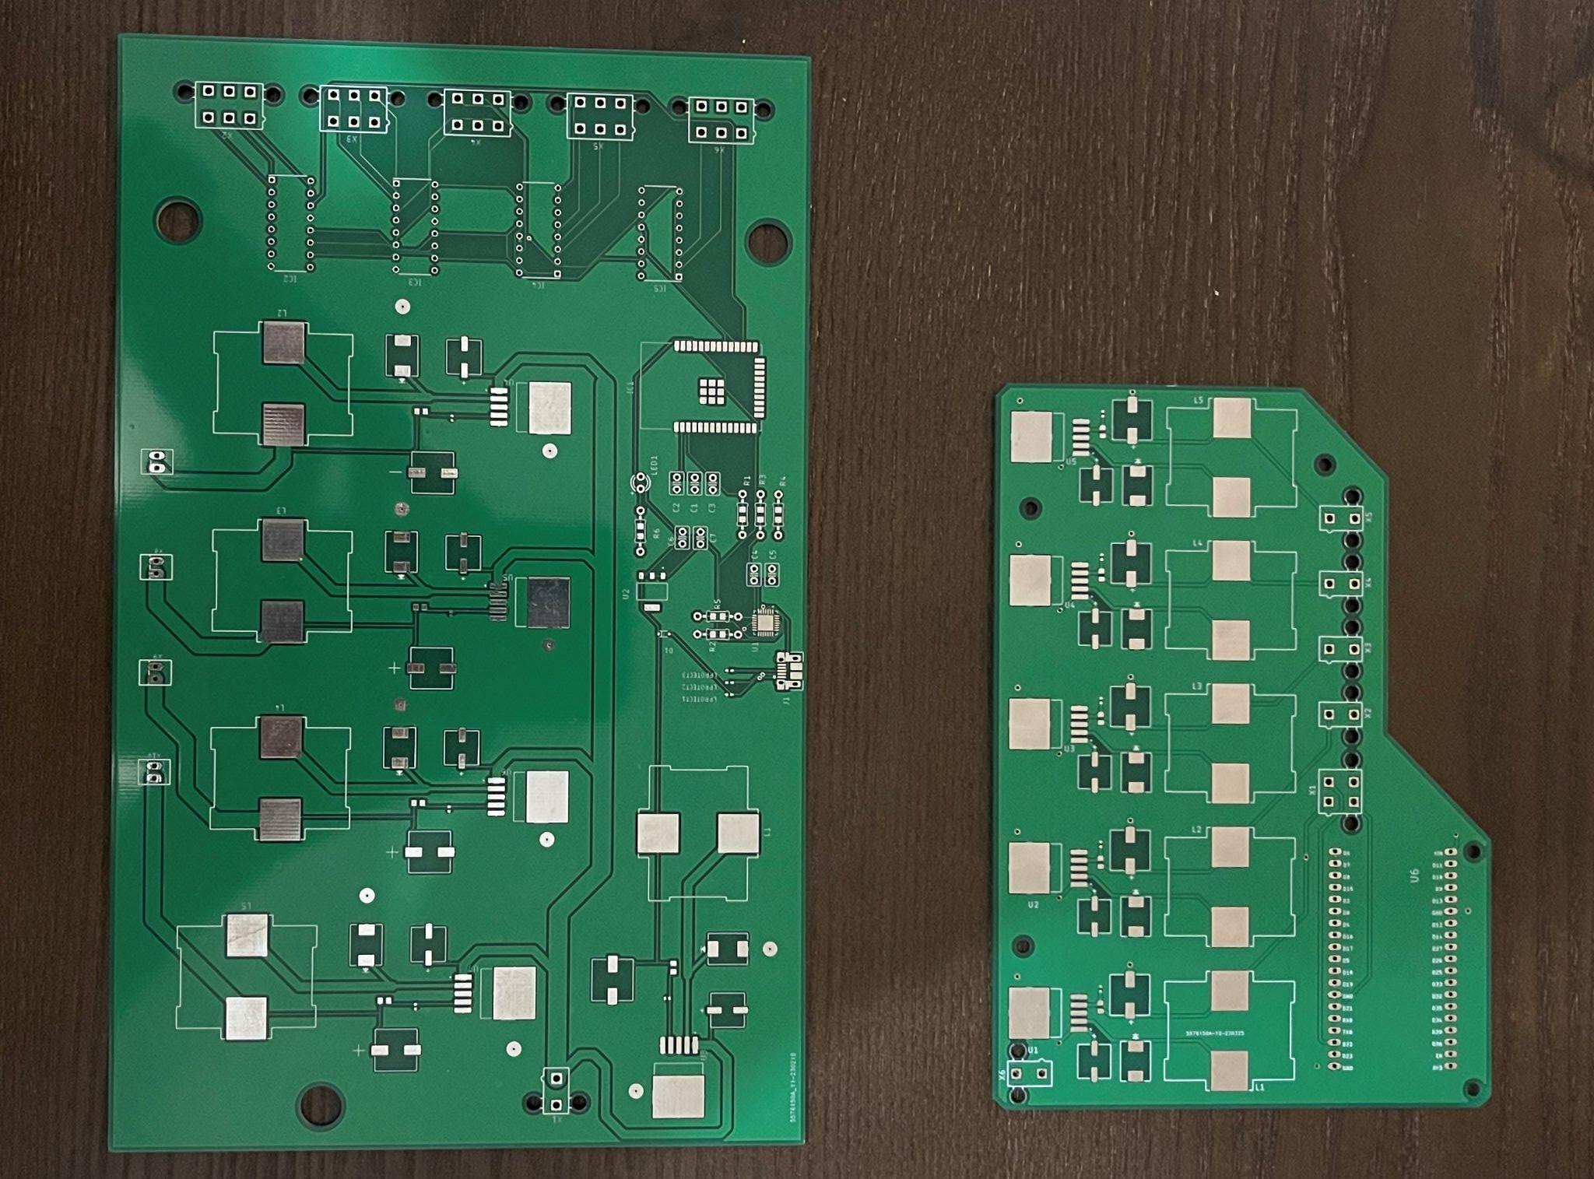
Detailed Design: PCB Construction
Second version of our PCB we reduced the size greatly
Lowered cost
Cleaned up circuit design
Switched to ESP-32 Dev Board
Changed connection to servo motors
Notes:
Kyle

Slide 27
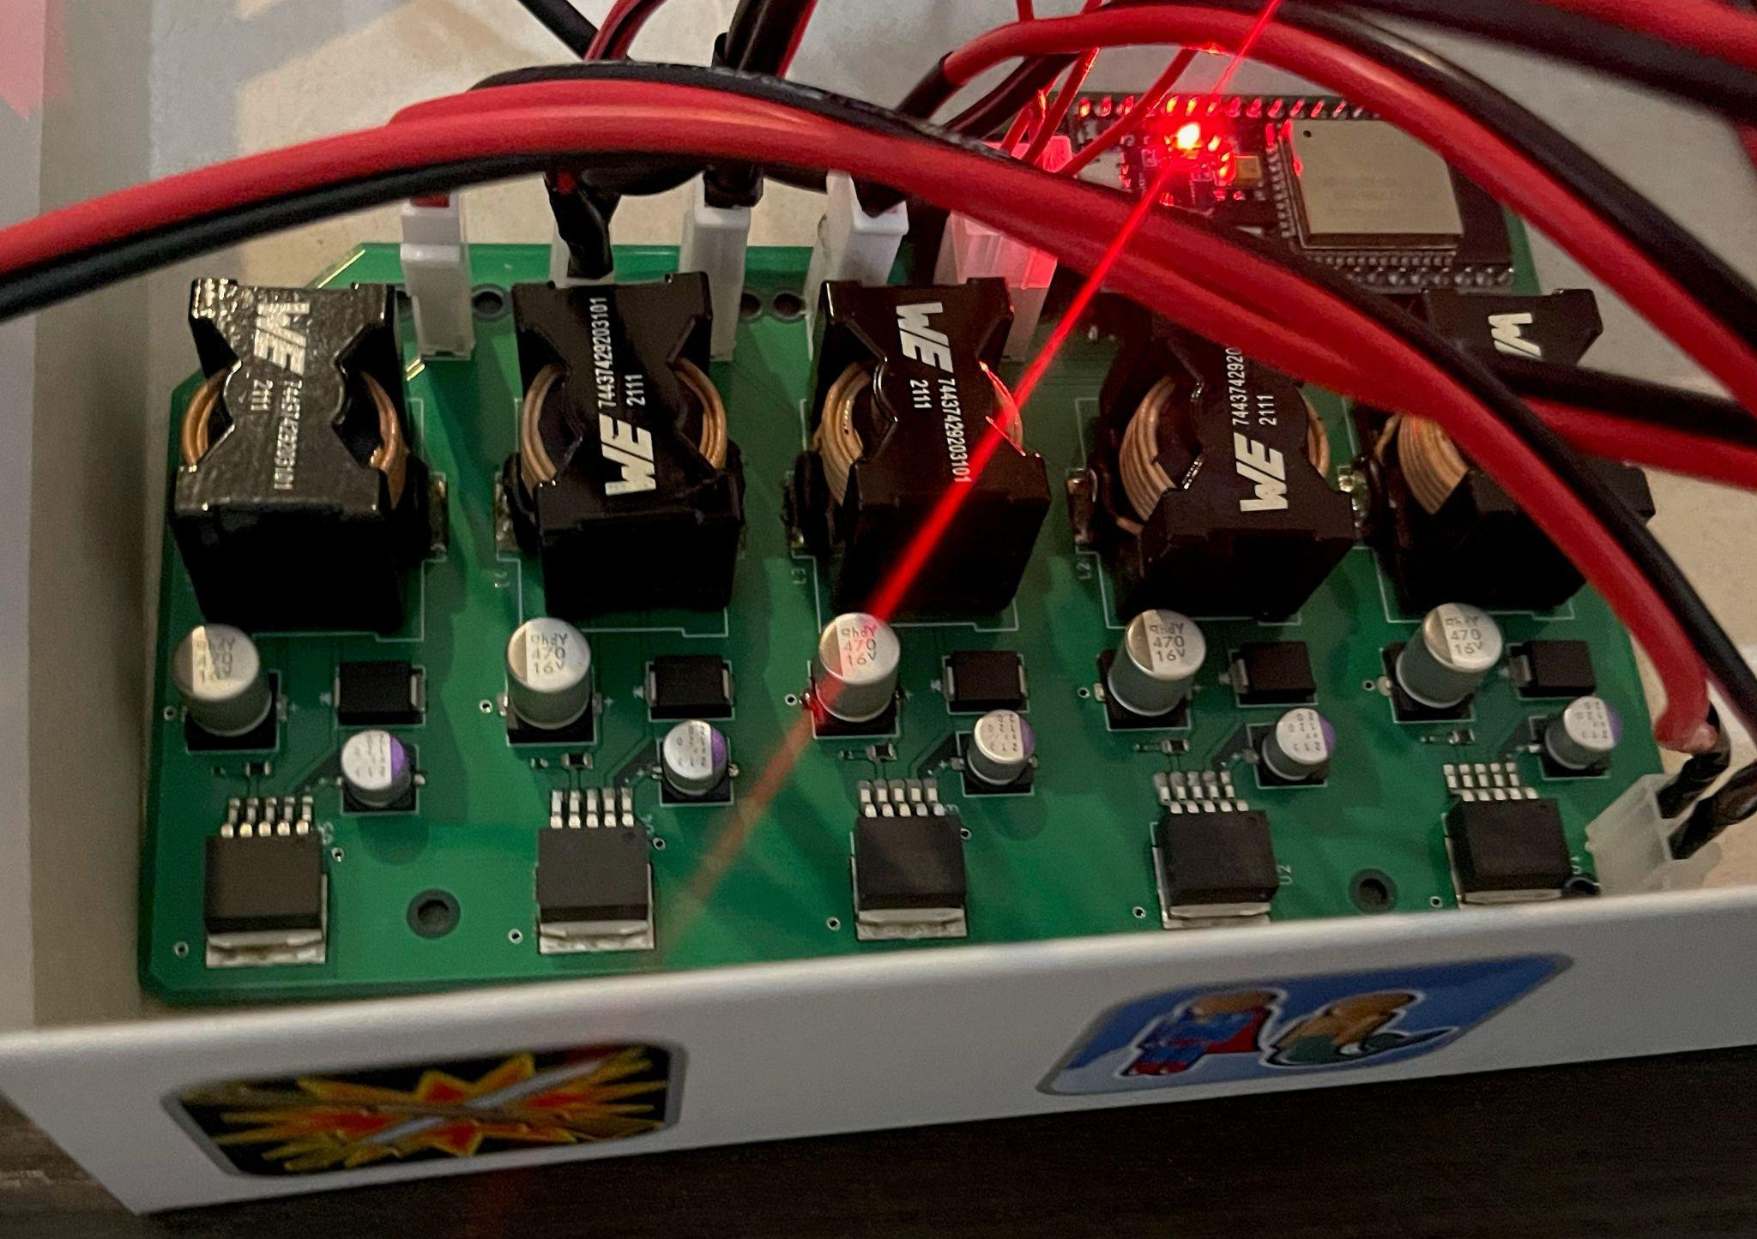
Detailed Design: Final PCB
Used both SMD and through hole devices
Inductors gave us troubles needed to be hand soldered
0402 resistors got disconnected which was difficult to hand soldered
Used two pin molex connectors to connect power directly to Servo Shields
ESP 32 footprint was not exact requiring us to bend the pins in order to ensure a proper fit
Notes:
Kyle

Slide 28
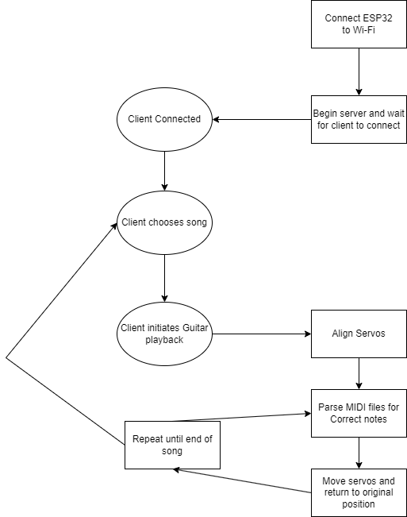
Microcontroller Operation Code
Basic operation of Microcontroller
Notes:
Blake

Slide 29
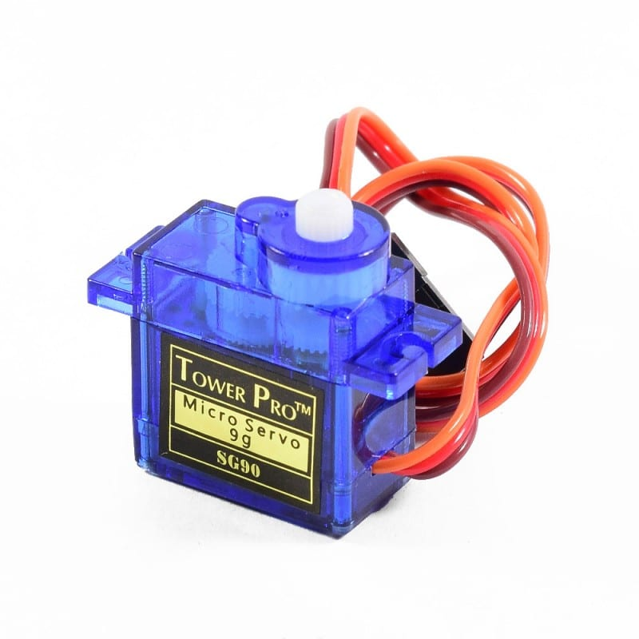
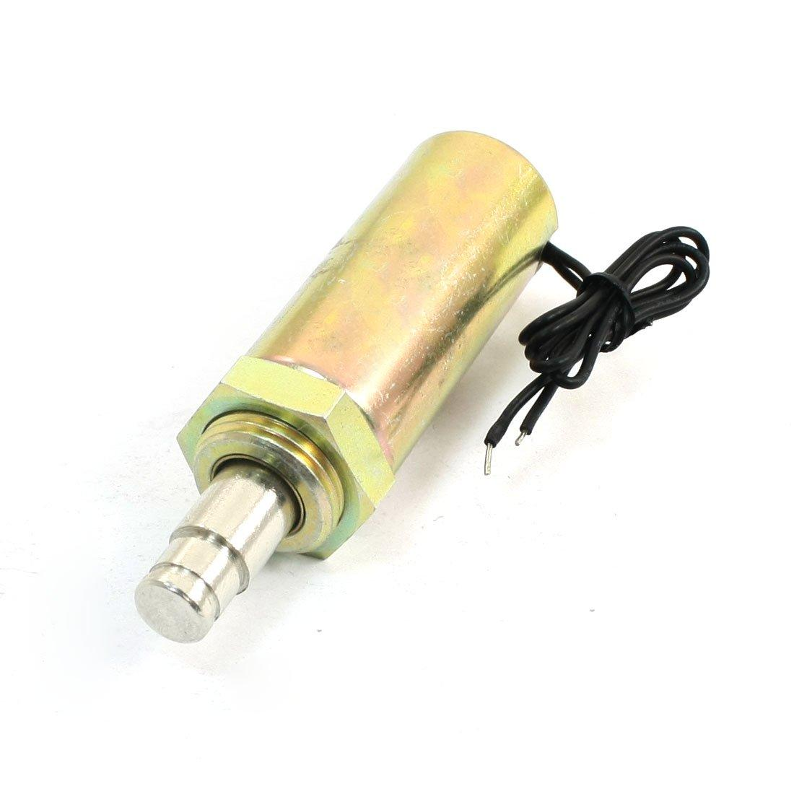
Servos Vs Solenoids
Ultimately we went with servos due to being cost efficient and having a lower voltage requirement.
Servo | Solenoid
< $2 per servo | > $9 per solenoid
Requires 4-6V | Requires 12V
Has to be adapted for linear actuation | Already is a linear actuator
Actuation is slower than a Solenoid | Fast actuation
Notes:
Blake

Slide 30
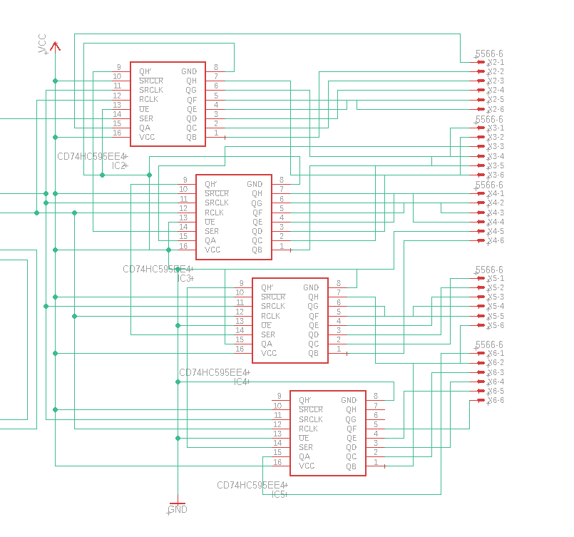
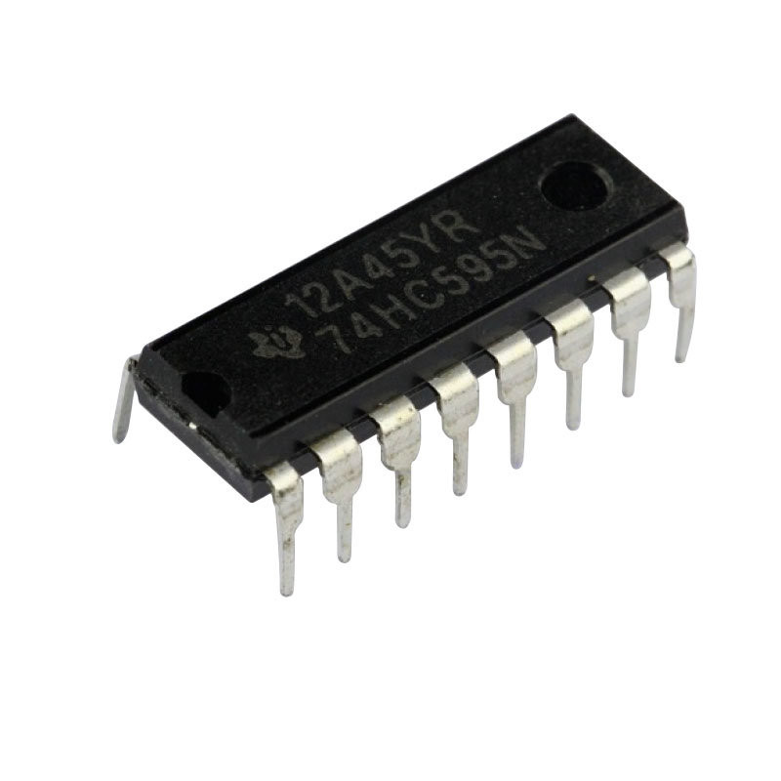
Servo Control
First Attempt To control our servos we will use 74HC595N shift registers.
Inexpensive
Shift Registers are daisy chained together
This saves pins on our microcontroller
Notes:
Blake

Slide 31
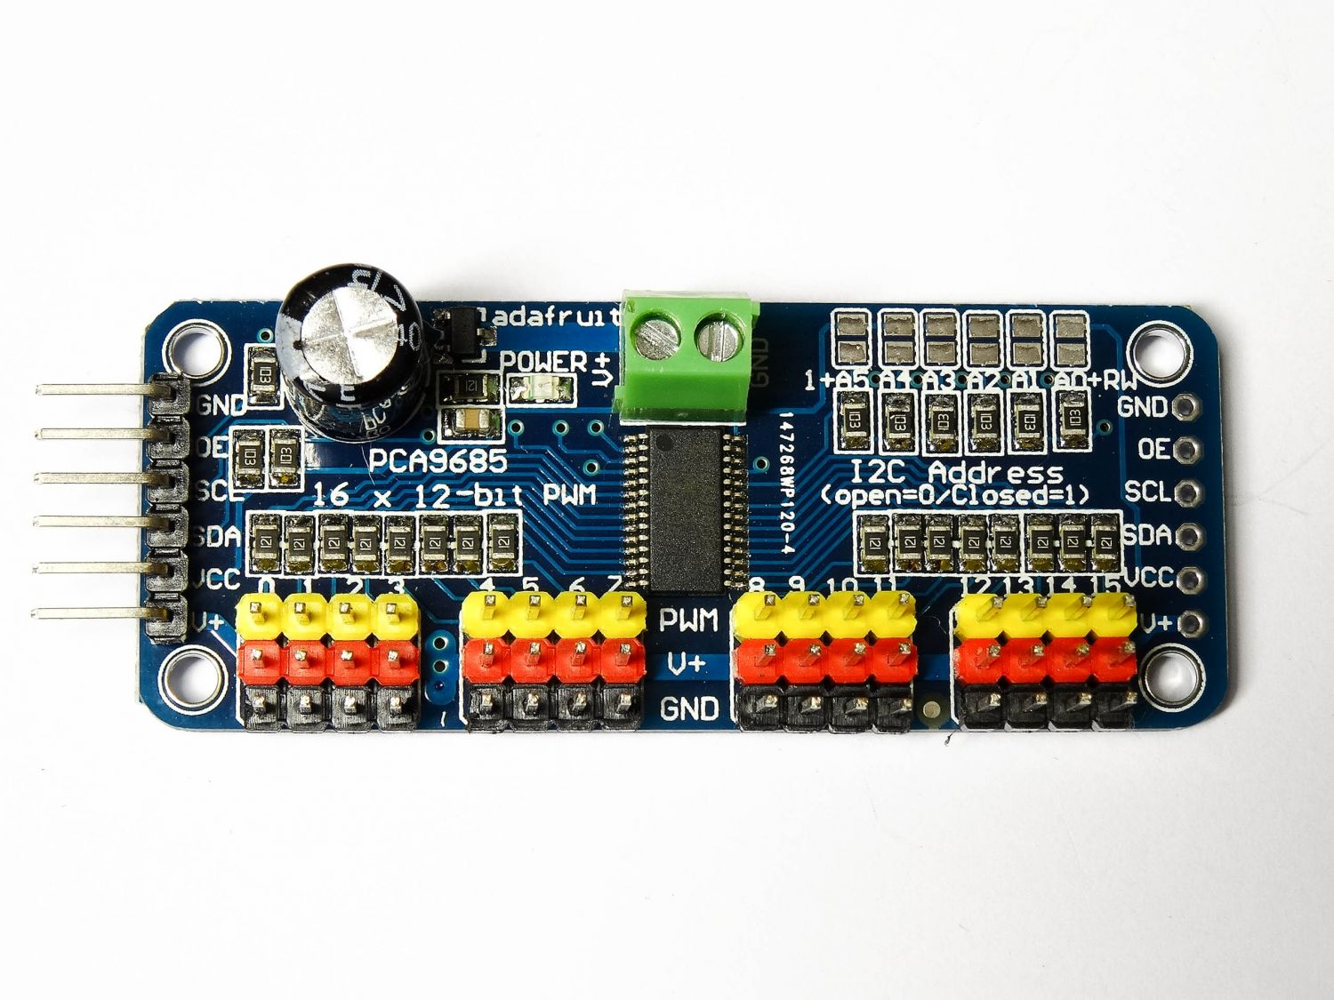
Problems With Shift Register Design
The Design was functional but had a few issues
Due to the platform that we were using there was no way to control the angle of the individual servos to account for different lengths of servo arms
Also was difficult to debug on breadboard
We switched to using PCA9685 Servo Shields which had 16 PWM pins which can give us better control of the servo angles.
It is controlled with I2C.

Slide 32
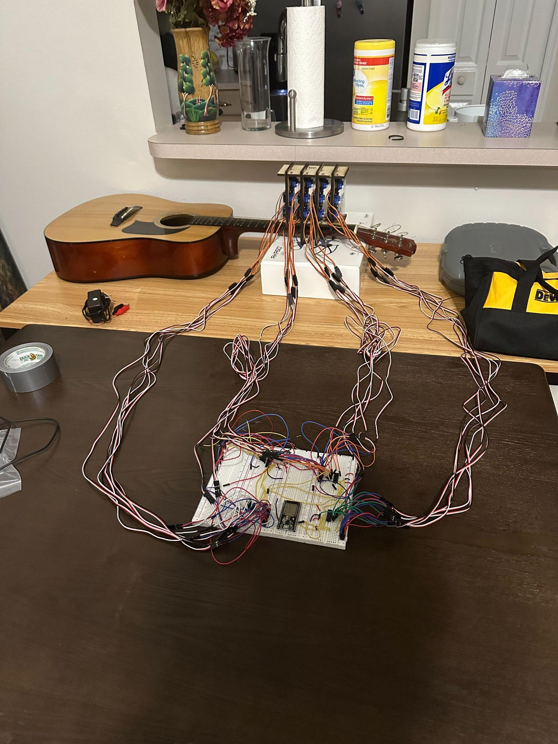
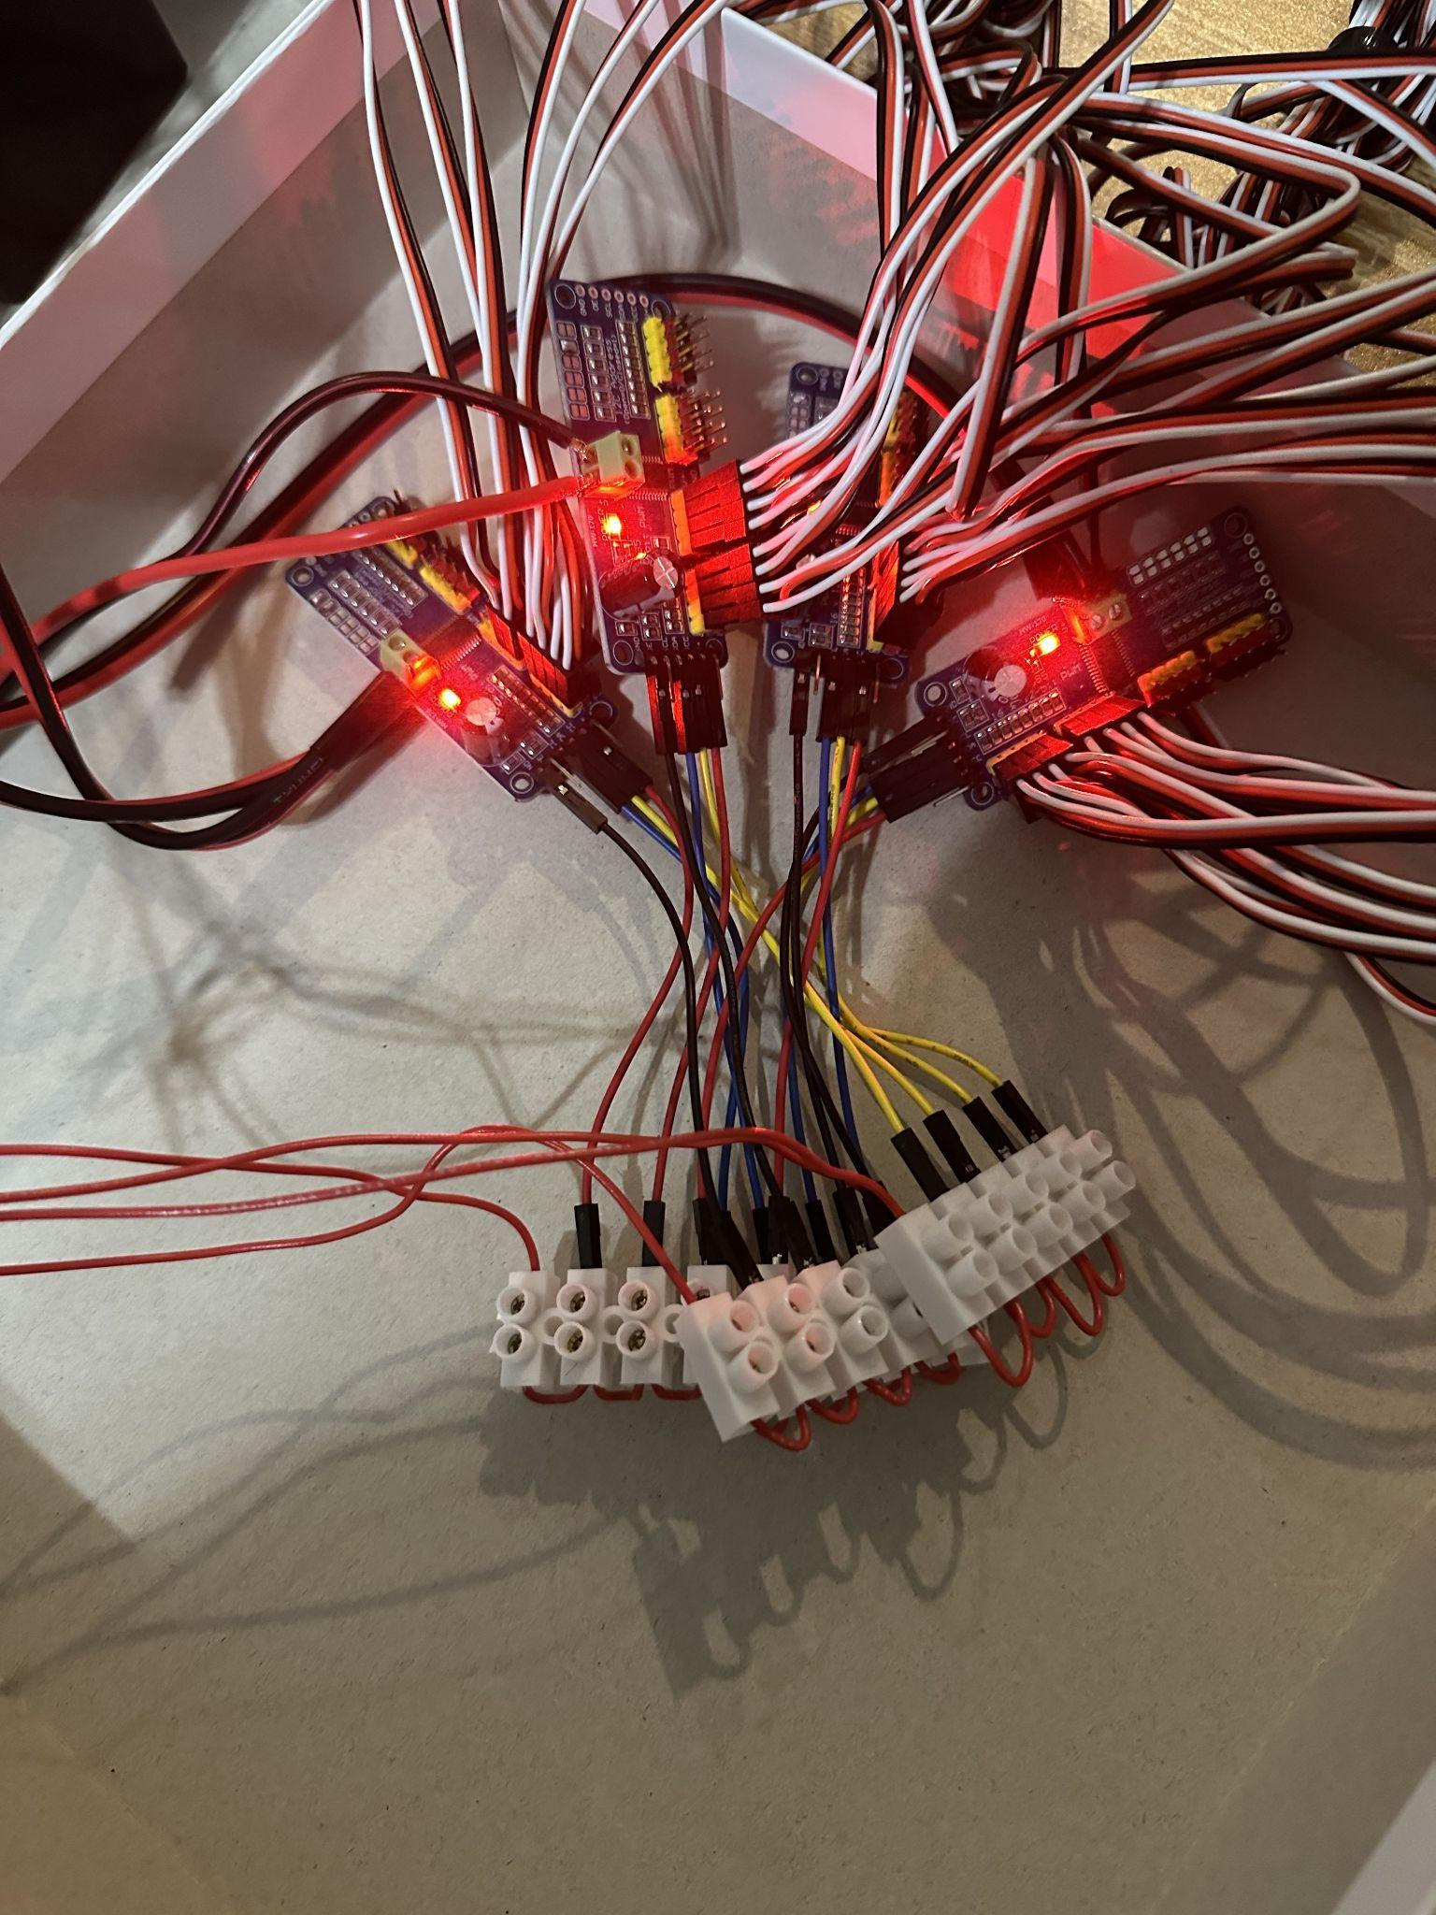
Motor Control Prototypes
Image on the left is the Shift Register Prototype, right is the Servo shield .
Used 4 Servo Shields to Distribute Power better.
Notes:
Blake

Slide 33
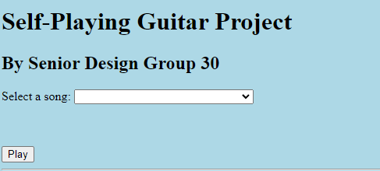
Communication
We will be using a HTTP Web server for the project.
Originally attempted to use Bluetooth but decided it would be simpler to use a Wi-Fi Connection.
Hyperlinks are used to communicate the information back to the ESP32.
Barebones UI will only have Song selection and play button.
Stop button implemented in hardware using a button interrupt.
Notes:
Blake

Slide 34
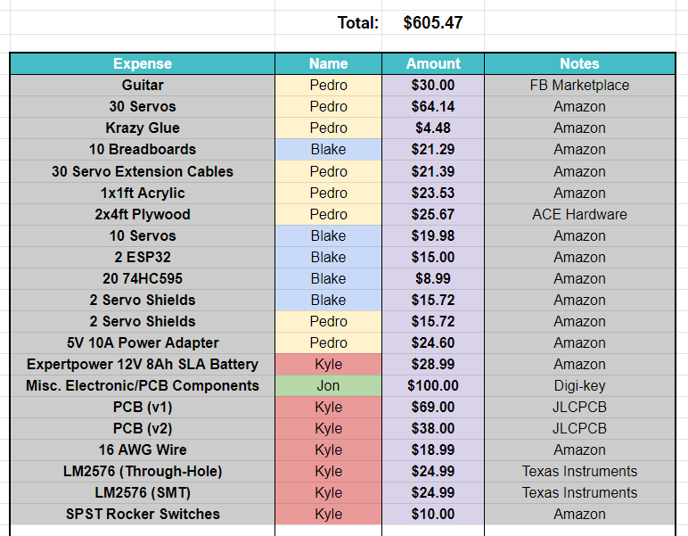

Budget / Finances
Thanks to our generous sponsors:
Notes:
Pedro

Slide 35
Stretch Goals
Fully acrylic mounts ✅
More robust, no issues with fretting components getting stuck
Cleaner look and design, easier to debug
Expansion of note range (using more frets on guitar)
Would offer better sound quality
LCD Screen / File Upload
Notes:
Pedro

Slide 36
Final Progress
MIDI Preprocessing Algorithm: 100%
Motor Output Algorithm: 100%
Wi-Fi Connection / Server / UI: 100%
Fretting Mount: 100%
Strumming Mount: 100%
Wiring: 100%
PCB Circuit Design: 100%
PCB Implementation: 100%
Testing/Debugging: 100%
Stretch Goals: 1 of 3 completed
Final Implementation: 100%
Notes:
Pedro

Slide 37
Questions?
Notes:
Pedro

